Slide 1

A general-purpose pipeline to interface the Tympan hardware with an external computer
Danielle Benesch^{1,2*}, Nithin Raj¹, Jérémie Voix^{1,2}
The 181st Meeting of the Acoustical Society of America
4aPP, Open Source Audio Processing Challenge Results
Hackathon Challenge Presentations
December 2nd, 2021
¹ NSERC-EERS Industrial Research Chair in In-Ear Technologies (CRITIAS), École de technologie supérieure
² Center for Interdisciplinary Research in Music Media and Technology (CIRMMT), McGill University
* Contact: dbenesch@critias.ca

Slide 2






Decreased sound tolerance
⬤ ● ● ● ⭘ ○ ○ ⭘ ○ ○
“The feeling is so intense it feels like pain, I know it’s not pain but it reminds me, it’s very very similar to physical pain” (from Landon et al., 2016).
→ Hearing protectors are often used to alleviate sound-induced distress (Neave-DiToro et al., 2021; Jastreboff & Jastreboff, 2014).
Motivation – Initial prototypes – Hackathon Submission

Slide 3




Over-attenuation
Conventional hearing protectors attenuate all sounds.
→ Can reduce engagement with surroundings (Pfeiffer et al., 2019a).
→ May worsen sensitivities over time (Formby et al., 2003; Jastreboff & Jastreboff, 2014).
Motivation – Initial prototypes – Hackathon Submission

Slide 4
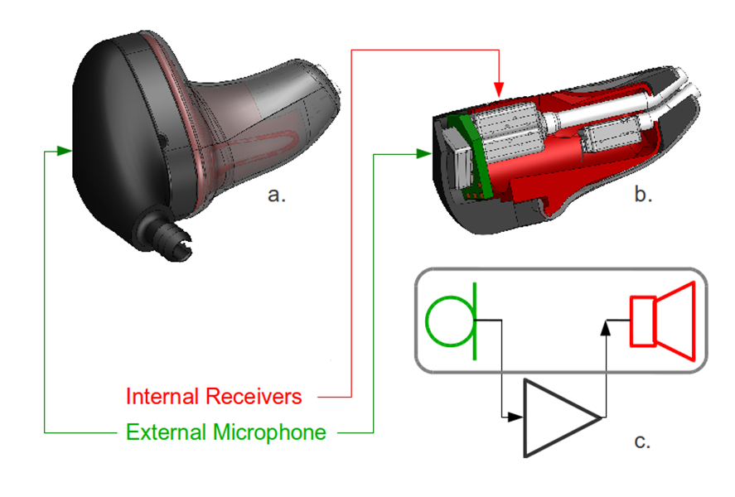








Project objective
→ A hearable to manage decreased sound tolerance with attenuation only when necessary.
Outer-ear microphone
Acoustic transparency with adaptive feedback cancellation
In-ear speaker
Amplifier
a.
b.
Voice activity detection
Masking noise
c.
Motivation – Initial prototypes – Hackathon Submission

Slide 5
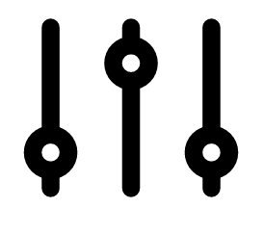
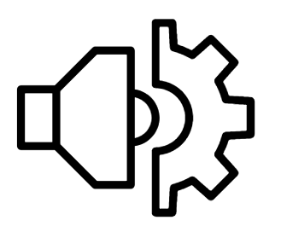



Project components
Control of audio processing
Low-latency audio processing
Voice activity detection
Acoustic transparency with adaptive feedback cancellation
f1
f2
Alarm sound detection
Masking noise
f1
f2
Detection of distressing sounds
Dynamic range limiting
f1
dB
f2
dB
Manual user controls
Frequency filtering
dB
Hz
Motivation – Initial prototypes – Hackathon Submission

Slide 6

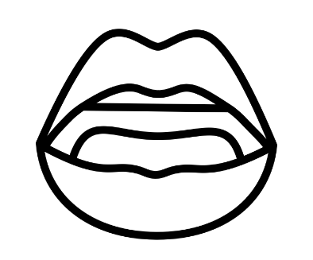
Audio processing latency requirements
Delay between original & actively transmitted signals
Multiple perceptual effects
Two distinct audio signals (echo threshold)
Audiovisual asynchrony (lip sync error)
These effects may differ for individuals with decreased sound tolerance
E.g. audiovisual temporal processing differs in children on the autism spectrum (Noel et al., 2017)
Hearing aid latency: usually < 9-10 ms (Alexander, 2016)
Motivation – Initial prototypes – Hackathon Submission

Slide 7
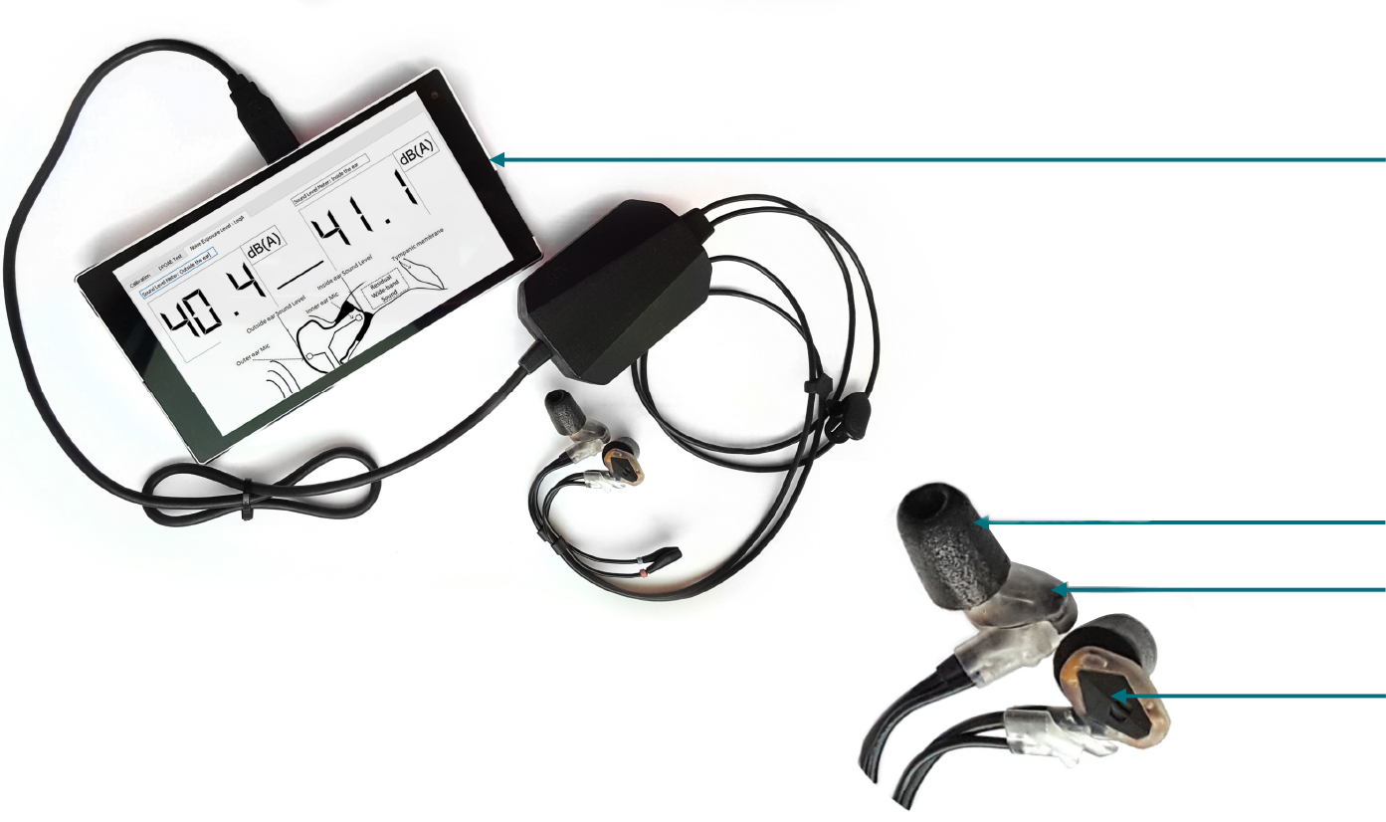

Prototype #1: Mini-PC
Auditory research platform 3.1: device developed within CRITIAS
Mini-PC
Ear tip
In-ear speaker
Outer-ear microphone
Motivation – Initial prototypes – Hackathon Submission

Slide 8
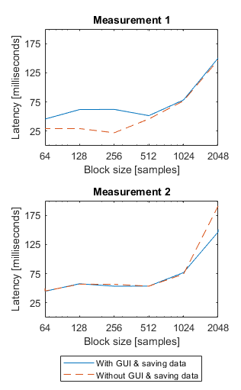
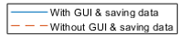
Prototype #1: Challenges
Measured latency of passthru in Matlab:
Fixed sampling rate of 44.1 kHz
Varied block size, if GUI + recording
Minimum: 22 ms
Block size of 256, w/o GUI + recording
57 ms in later measurement
→ PC not suitable for low-latency audio processing
Motivation – Initial prototypes – Hackathon Submission

Slide 9
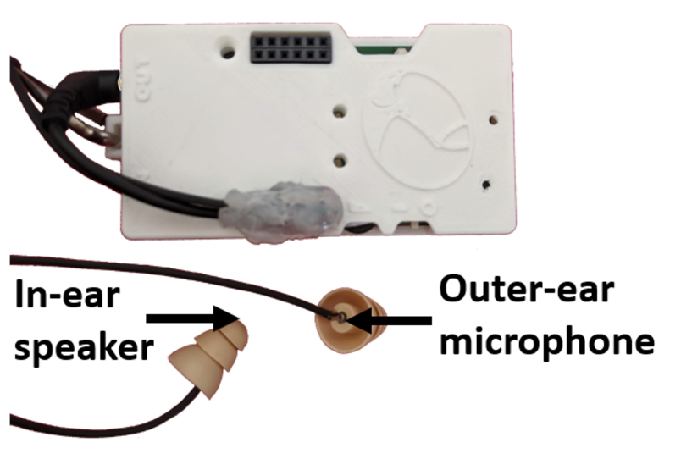
Prototype #2: Tympan
Tympan Open-Source Hearing Aid Platform, Rev-D + CRITIAS earpieces
Tympan hardware
In-ear speaker
Outer-ear microphone
Ear tip
Motivation – Initial prototypes – Hackathon Submission

Slide 10
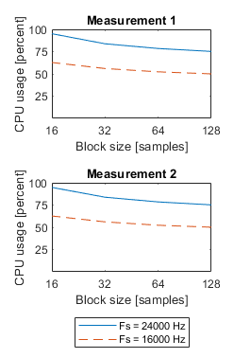
Prototype #2: Challenges
CPU usage
Rev-D: 91% for 1-channel 8-band IIR WDRC with AFC, fs = 24000 & block size = 16
Rev-E: 97% for 2-channel 16-band FIR WDRC, fs = 44117 & block size = 16
Need to adapt machine learning algorithms for embedded system
→ Tympan well-suited for real-time audio processing, but limited for automatic control of audio processing
Motivation – Initial prototypes – Hackathon Submission

Slide 11

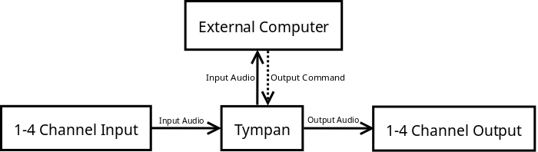


Prototype #3: PC + Tympan
→ Pipeline to interface Tympan with an external PC
Outer-ear microphone
In-ear speaker
Motivation – Initial prototypes – Hackathon Submission

Slide 12
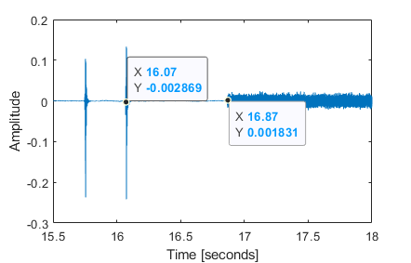




Prototype #3: Hackathon project
White noise player toggled with clap detection
Earpiece speaker
White noise
Amplifier
Tympan microphone
Clap detection with pi-clap
f1
f2
~800 ms to toggle
Motivation – Initial prototypes – Hackathon Submission

Slide 13
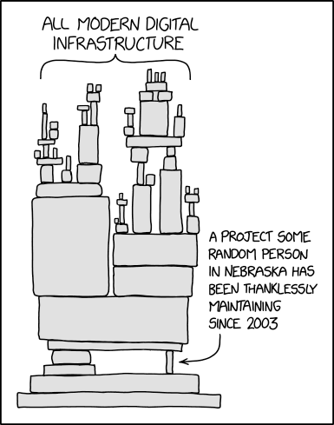
Prototype #3: Challenges
Not a simple addition to Tympan library
Tested on Python 3.8.10, Arduino 1.8.15 & Teensy 1.54
Needed to modify Teensy library
Had to adapt code to new machine (Ubuntu → Windows)
Source: xkcd
Motivation – Initial prototypes – Hackathon Submission

Slide 14




Future possibilities
Potential extensions of pipeline:
Wireless transmission
GUI to inform device usage
Software to record “in situ” research data
Promise of open-source hardware & software for decreased sound tolerance research
96 dBA
Motivation – Initial prototypes – Hackathon Submission

Slide 15




Thank you!
Tympan Team
Dr. Rachel Bouserhal (co-supervisor)
CIRMMT Travel Award
ASA student transportation subsidies
ÉTS financial support for the dissemination and promotion of research

